Slide 1

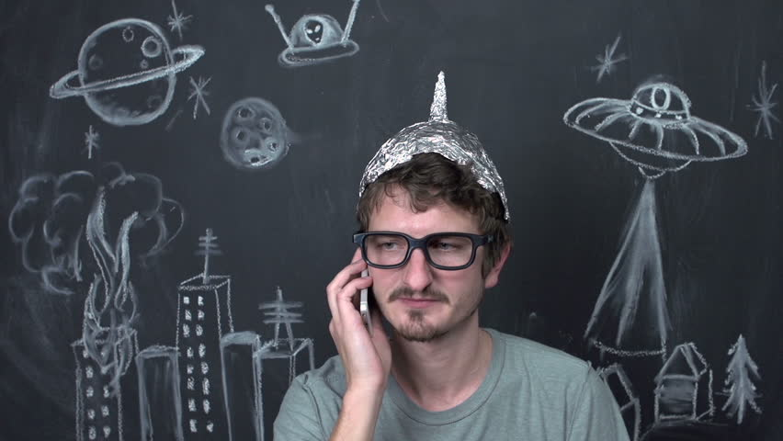
“Tik-Tok is just spyware sponsored by the Chinese government to destabilize our Western values.”
Derek Arnold
28 years old
Pontiac, MI
Diesel mechanic
Enjoys his privacy and consuming memes
Suspicious, moody, inquisitive
Pains
Gains
A safe space to consume online media without any tracking
Being tracked by the government
User metadata being sold to corporations

Slide 2
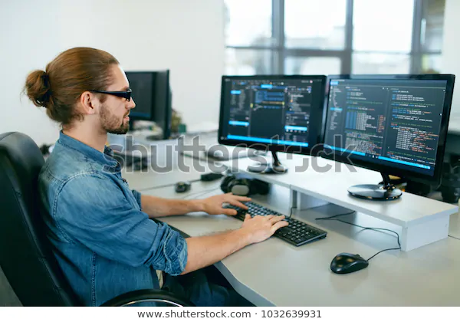
“I spend a lot of time in front of a computer screen for work, but I'd still like to enjoy sharing GIFs with friends.”
Nik Ambrose
36 years old
NYC, New York
Sys Admin
Suffers from Computer Vision Syndrome
Outgoing, funny, kind
Pains
Webpages with high contrast, lots of moving images, and ads
Gains
Finding a website to enjoy GIFs without becoming physically ill

